Slide 1
Lecture 11: Virtualizing Memory – TLB and Advanced Paging

Slide 2
The Course Organization (Bottom-up)
Race Conditions, Lock/Semaphore
Concurrency
Thread
Memory Management
HW#4
Virtualization
Process and CPU Scheduling
HW#3
IO Devices and Storage
HW#2
&
Project
Persistence
File System
System Calls (User-level Programming)
HW#1

Slide 3
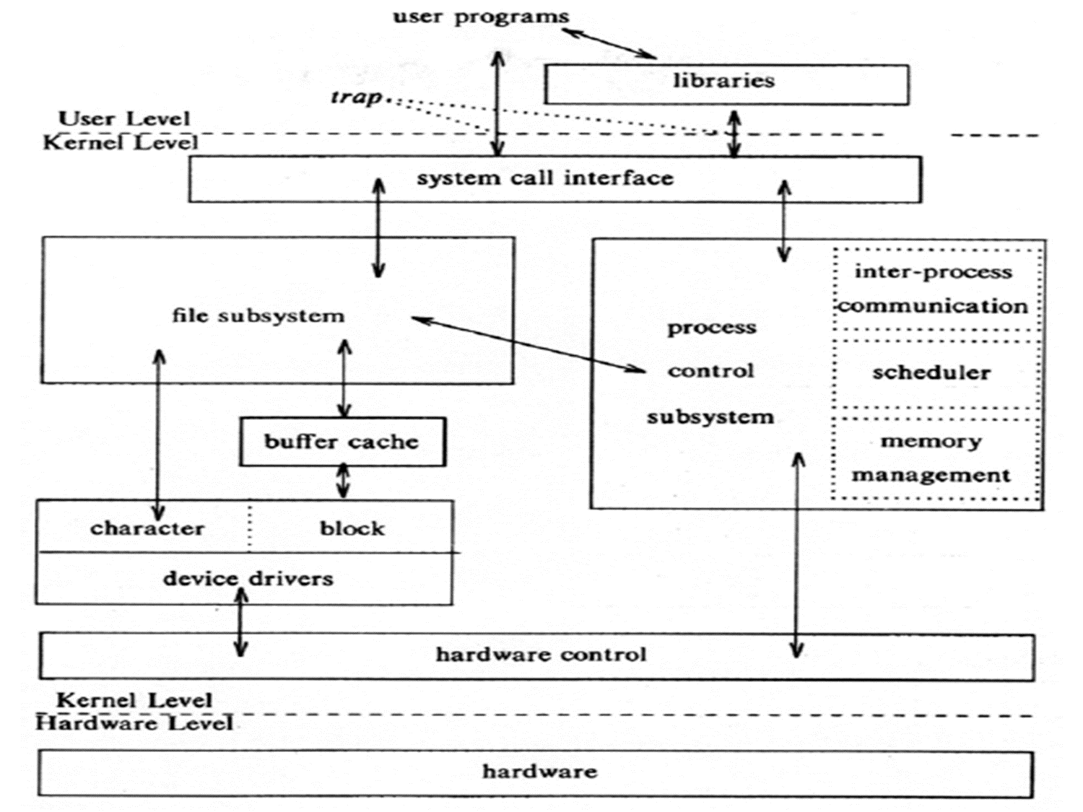
OS – Resource management via virtualization
OS provides services via System Call (typically a few hundred) to run process, access memory/devices/files, etc.
The OS manages resources such as CPU, memory and disk via virtualization.
many programs to run (processes) → Sharing the CPU
many processes to concurrently access their own instructions and data → Sharing memory
many processes to access devices → Sharing disks
The Design Of The Unix Operating System (Maurice Bach, 1986)

Slide 4
Part I: TLB (Translation Lookaside Buffer)

Slide 5
TLB
Part of the chip’s memory-management unit(MMU).
A hardware cache of popular virtual-to-physical address translation.
TLB
Lookup
MMU
Logical
Address
TLB Hit
Physical
Address
TLB
popular v to p
TLB Miss
CPU
Page Table
all v to p entries
Page 0
Page 1
Page 2
…
Page n
Address Translation with MMU
Physical Memory
Notes:
말그대로 파풀러한 애들을 캐시해주는 거니까 그림이 잘못됬음.

Slide 6
TLB Basic Algorithm
1: VPN = (VirtualAddress & VPN_MASK ) >> SHIFT
2: (Success , TlbEntry) = TLB_Lookup(VPN)
3: if(Success == Ture){ // TLB Hit
4: if(CanAccess(TlbEntry.ProtectBit) == True ){
5: offset = VirtualAddress & OFFSET_MASK
6: PhysAddr = (TlbEntry.PFN << SHIFT) | Offset
7: AccessMemory( PhysAddr )
8: }else RaiseException(PROTECTION_ERROR)
(1 lines) extract the virtual page number(VPN).
(2 lines) check if the TLB holds the transalation for this VPN.
(5-8 lines) extract the page frame number from the relevant TLB entry, and form the desired physical address and access memory.

Slide 7
TLB Basic Algorithm (Cont.)
11:}else{ //TLB Miss
12: PTEAddr = PTBR + (VPN * sizeof(PTE))
13: PTE = AccessMemory(PTEAddr)
14: (…)
15: }else{
16: TLB_Insert( VPN , PTE.PFN , PTE.ProtectBits)
17: RetryInstruction()
18: }
19:}
(11-12 lines) The hardware accesses the page table to find the translation.
(16 lines) updates the TLB with the translation.

Slide 8
Example: Accessing An Array
How a TLB can improve its performance.
OFFSET 00 04 08 12 16
VPN = 00
VPN = 01
VPN = 03
VPN = 04
VPN = 05
VPN = 06 |  | a[0] | a[1] | a[2]
VPN = 07 | a[3] | a[4] | a[5] | a[6]
VPN = 08 | a[7] | a[8] | a[9]
VPN = 09
VPN = 10
VPN = 11
VPN = 12
VPN = 13
VPN = 14
VPN = 15
0: int sum = 0 ;
1: for( i=0; i<10; i++){
2: sum+=a[i];
3: }
The TLB improves performance
due to spatial locality
3 misses and 7 hits.
Thus TLB hit rate is 70%.

Slide 9
Locality
Temporal Locality
An instruction or data item that has been recently accessed will likely be re-accessed soon in the future.
Spatial Locality
If a program accesses memory at address x, it will likely soon access memory near x.
1st access is page1.
2nd access is also page1.
Page 6
…
Page 1
Page 7
Page 2
Page 3
Page 4
Page 5
Page n
Virtual Memory
1st access is page1.
2nd access is near by page1.
Page 1
Page 2
Page 3
Page 4
Page 5
…
Page n
Virtual Memory

Slide 10
Who Handles The TLB Miss?
Hardware handle the TLB miss entirely on CISC.
The hardware has to know exactly where the page tables are located in memory.
The hardware would “walk” the page table, find the correct page-table entry and extract the desired translation, update and retry instruction.
hardware-managed TLB.
RISC have what is known as a software-managed TLB.
On a TLB miss, the hardware raises exception( trap handler ).
Trap handler is code within the OS that is written with the express purpose of handling TLB miss.

Slide 11
TLB entry
TLB is managed by Full Associative method.
A typical TLB might have 32,64, or 128 entries.
Hardware search the entire TLB in parallel to find the desired translation.
other bits: valid bits , protection bits, address-space identifier, dirty bit
VPN
PFN
other bits
Typical TLB entry look like this

Slide 12
TLB Issue: Context Switching
Page 0
Page 1
Process A
Page 2
Insert TLB Entry
access VPN10
…
Page n
TLB Table
Virtual Memory
VPN | PFN | valid | prot
10 | 100 | 1 | rwx
- | - | - | -
- | - | - | -
- | - | - | -
Page 0
Process B
Page 1
Page 2
…
Page n
Virtual Memory
Notes:
현재 프로세스 A, B의 주소공간을 가상공간으로 변경 예정

Slide 13
TLB Issue: Context Switching
Page 0
Page 1
Process A
Page 2
…
Page n
TLB Table
Virtual Memory
VPN | PFN | valid | prot
10 | 100 | 1 | rwx
- | - | - | -
10 | 170 | 1 | rwx
- | - | - | -
Context
Switching
Page 0
Process B
access VPN10
Page 1
Page 2
Insert TLB Entry
…
Page n
Virtual Memory
Notes:
현재 프로세스 A, B의 주소공간을 가상공간으로 변경 예정

Slide 14
TLB Issue: Context Switching
Page 0
Page 1
Process A
Page 2
…
Page n
TLB Table
Virtual Memory
VPN | PFN | valid | prot
10 | 100 | 1 | rwx
- | - | - | -
10 | 170 | 1 | rwx
- | - | - | -
Page 0
Process B
Page 1
Page 2
…
Can’t distinguish which entry is
meant for which process
Page n
Virtual Memory
Notes:
현재 프로세스 A, B의 주소공간을 가상공간으로 변경 예정

Slide 15
To Solve Problem
Provide an address space identifier(ASID) field in the TLB.
Page 0
Page 1
Process A
Page 2
…
TLB Table
Page n
VPN | PFN | valid | prot | ASID
10 | 100 | 1 | rwx | 1
- | - | - | - | -
10 | 170 | 1 | rwx | 2
- | - | - | - | -
Virtual Memory
Page 0
Process B
Page 1
Page 2
…
Page n
Virtual Memory

Slide 16
Another Case
Two processes share a page.
Process 1 is sharing physical page 101 with Process2.
P1 maps this page into the 10th page of its address space.
P2 maps this page to the 50th page of its address space.
VPN | PFN | valid | prot | ASID
10 | 101 | 1 | rwx | 1
- | - | - | - | -
50 | 101 | 1 | rwx | 2
- | - | - | - | -
Sharing of physical pages is useful as it reduces the number of physical pages in use.

Slide 17
TLB Replacement Policy
LRU(Least Recently Used)
Evict an entry that has not recently been used.
Take advantage of locality in the memory-reference stream.
Reference Row
7
0
1
2
0
3
0
4
2
3
0
3
2
1
2
0
1
7
7
7
2
2
4
4
4
0
1
1
Page Frame:
0
0
0
0
0
0
3
3
3
0
1
1
3
3
2
2
2
2
2
Total 11 TLB miss

Slide 18

A Real TLB Entry
All 64 bits of this TLB entry(example of MIPS R4000)
0 1 2 3 4 5 6 7 8 9
10 11 … 19 … 31
VPN
G
ASID
PFN
C
D
V
Flag | Content
19-bit VPN | The rest reserved for the kernel.
24-bit PFN | Systems can support with up to 64GB of main memory( $2^{24}∗4KB$ pages ).
Global bit(G) | Used for pages that are globally-shared among processes.
ASID | OS can use to distinguish between address spaces.
Coherence bit(C) | determine how a page is cached by the hardware.
Dirty bit(D) | marking when the page has been written.
Valid bit(V) | tells the hardware if there is a valid translation present in the entry.

Slide 19
Part II: Advanced Paging

Slide 20

Paging: Linear Tables
We usually have one page table for every process in the system.
Assume that 32-bit address space with 4KB pages and 4-byte page-table entry.
4B
entry
4KB
Page 0
entry
entry
Page 1
…
Page 2
…
entry
Page n
Page Table of
Process A
Physical Memory
Page table size = $\frac{2^{32}}{2^{12}}∗4Byte=4MByte$
Page tables are too big and thus consume too much memory.

Slide 21

Paging: Smaller Tables
Page table are too big and thus consume too much memory.
Assume that 32-bit address space with 16KB pages and 4-byte page-table entry.
4B
entry
16KB
Page 0
entry
entry
Page 1
…
Page 2
…
entry
Page n
Page Table of
Process A
Physical Memory
$\frac{2^{32}}{2^{14}}∗4=1MB$ per page table
Big pages lead to internal fragmentation.

Slide 22
Problem
Single page table for the entries address space of a process.
Physical Memory
Virtual Address
Space
0
1
2
3
4
5
6
7
8
9
10
11
12
13
14
15
16
17
18
19
20
21
22
23
24
25
PFN | valid | prot | present | dirty
9 | 1 | r-x | 1 | 0
- | 0 | - | - | -
- | 0 | - | - | -
- | 0 | - | - | -
15 | 1 | rw- | 1 | 1
… | … | … | … | …
- | 0 | - | - | -
3 | 1 | rw- | 1 | 1
23 | 1 | rw- | 1 | 1
code
 | 0
 | 1
 | 2
 | 3
 | 4
 | 5
 | 6
 | 7
 | 8
 | 9
 | 10
 | 11
 | 12
 | 13
 | 14
Allocate
heap
…
stack
A Page Table For 16KB Address Space
…
A 16KB Address Space with 1KB Pages

Slide 23
Problem
Most of the page table is unused, full of invalid entries.
Physical Memory
Virtual Address
Space
0
1
2
3
4
5
6
7
8
9
10
11
12
13
14
15
16
17
18
19
20
21
22
23
24
25
PFN | valid | prot | present | dirty
9 | 1 | r-x | 1 | 0
- | 0 | - | - | -
- | 0 | - | - | -
- | 0 | - | - | -
15 | 1 | rw- | 1 | 1
… | … | … | … | …
- | 0 | - | - | -
3 | 1 | rw- | 1 | 1
23 | 1 | rw- | 1 | 1
code
 | 0
 | 1
 | 2
 | 3
 | 4
 | 5
 | 6
 | 7
 | 8
 | 9
 | 10
 | 11
 | 12
 | 13
 | 14
Allocate
heap
…
stack
A Page Table For 16KB Address Space
…
A 16KB Address Space with 1KB Pages

Slide 24
Hybrid Approach: Paging and Segments
In order to reduce the memory overhead of page tables.
Using base not to point to the segment itself but rather to hold the physical address of the page table of that segment.
The bounds register is used to indicate the end of the page table.

Slide 25
Simple Example of Hybrid Approach
Each process has three page tables associated with it.
When process is running, the base register for each of these segments contains the physical address of a linear page table for that segment.
31 30 29 28 27 26 25 24 23 22 21 20 19 18 17 16 15 14 13 12 11 10 9 8 7 6 5 4 3 2 1 0
Seg
VPN
Offset
32-bit Virtual address space with 4KB pages
Seg value | Content
00 | unused segment
01 | code
10 | heap
11 | stack

Slide 26
TLB miss on Hybrid Approach
The hardware gets the physical address from the page table.
The hardware uses the segment bits(SN) to determine which base and bounds pair to use.
The hardware then takes the physical address therein and combines it with the VPN as follows to form the address of the page table entry(PTE) .
01: SN = (VirtualAddress & SEG_MASK) >> SN_SHIFT
02: VPN = (VirtualAddress & VPN_MASK) >> VPN_SHIFT
03: AddressOfPTE = Base[SN] + (VPN * sizeof(PTE))

Slide 27
Problem of Hybrid Approach
Hybrid Approach is not without problems.
If we have a large but sparsely-used heap, we can still end up with a lot of page table waste.
External fragmentation arises again.

Slide 28
Multi-level Page Tables
Turns the linear page table into something like a tree.
Chop up the page table into page-sized units.
If an entire page of page-table entries is invalid, don’t allocate that page of the page table at all.
To track whether a page of the page table is valid, use a new structure, called page directory.

Slide 29
Multi-level Page Tables: Page directory
PTBR=Page Table Base Address PDBR=Page Directory Base Address
Linear Page Table
Multi-level Page Table
PTBR
201
PDBR
200
valid
prot
PFN
valid
valid
prot
PFN
PFN
1 | rx | 12
1 | rx | 13
0 | - | -
1 | rw | 100
0 | - | -
0 | - | -
0 | - | -
0 | - | -
0 | - | -
0 | - | -
1 | rw | 86
1 | rw | 15
1 | 201
0 | -
0 | -
1 | 203
1 | rx | 12
1 | rx | 13
0 | - | -
1 | rw | 100
PFN201
PFN200
PFN201
The Page Directory
[Page 1 of PT:Not Allocated]
PFN202
[Page 2 of PT: Not Allocated]
0 | - | -
0 | - | -
1 | rw | 86
1 | rw | 15
PFN203
PFN203
Linear (Left) And Multi-Level (Right) Page Tables

Slide 30
Multi-level Page Tables: Page directory entries
The page directory contains one entry per page of the page table.
It consists of a number of page directory entries(PDE).
PDE has a valid bit and page frame number(PFN).

Slide 31
Multi-level Page Tables: Advantage & Disadvantage
Advantage
Only allocates the page-table space in proportion to the amount of address space you are using.
The OS can grab the next free page when it needs to allocate or grow a page table.
Disadvantage
Multi-level table is a small example of a time-space trade-off.
Complexity.

Slide 32
Multi-level Page Table: Level of indirection
A multi-level structure can adjust level of indirection through use of the page directory.
Indirection place page-table pages wherever we would like in physical memory.

Slide 33
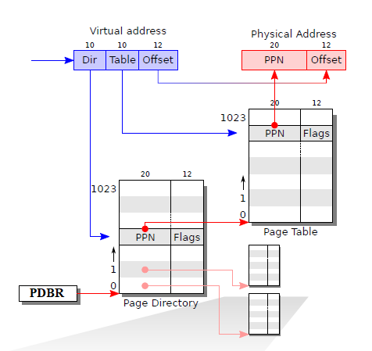
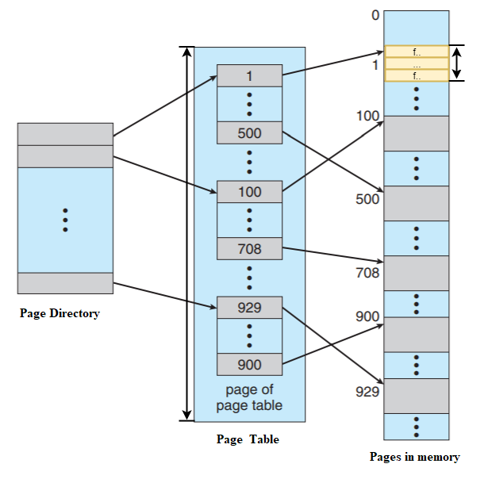
Example
Idea: direct mapping to indirect mapping

Slide 34

A Detailed Multi-Level Example
To understand the idea behind multi-level page tables better, let’s do an example.
00 0000 0000 0000
code
code
(free)
(free)
heap
heap
(free)
(free)
stack
stack
00 0000 0000 0001
...
Flag | Detail
Address space | 16 KB
Page size | 64 byte
Virtual address | 14 bit
VPN | 8 bit
Offset | 6 bit
Page table entry | $$2^{8}(256)$$
11 1111 1111 1111
A 16-KB Address Space With 64-byte Pages
13 | 12 | 11 | 10 | 9 | 8 | 7 | 6 | 5 | 4 | 3 | 2 | 1 | 0
VPN
Offset

Slide 35
A Detailed Multi-Level Example: Page Directory Idx
The page directory needs one entry (4 bytes) per page of the page table
it has 16 entries.
The page-directory entry is invalid → Raise an exception (The access is invalid)
Page Directory Index
13 | 12 | 11 | 10 | 9 | 8 | 7 | 6 | 5 | 4 | 3 | 2 | 1 | 0
VPN
Offset
14-bits Virtual address

Slide 36
A Detailed Multi-Level Example: Page Table Idx
The PDE is valid, we have more work to do.
To fetch the page table entry(PTE) from the page of the page table pointed to by this page-directory entry.
This page-table index can then be used to index into the page table itself.
Page Directory Index
Page Table Index
13 | 12 | 11 | 10 | 9 | 8 | 7 | 6 | 5 | 4 | 3 | 2 | 1 | 0
VPN
Offset
14-bits Virtual address

Slide 37
Example
Assumptions:
Each page is 4 KB (12 bits to represent its offsets from 0x 000 - 0x fff )
The virtual space of a process: 4GB (32-bit to represent from 0x 00000000 – 0x ffffffff)
Each entry in the page table is 4 B
How big for the page table to one process (map 4GB virtual space to 4GB physical space)
How many entries in the page table: 4GB/4KB = 1 M
How big: 1M * 4 B = 4 MB
If we have one thousand of processes running
The page table of each process is 4MB
The page tables of one thousand of processes is 4GB (ONLY for tables)

Slide 38
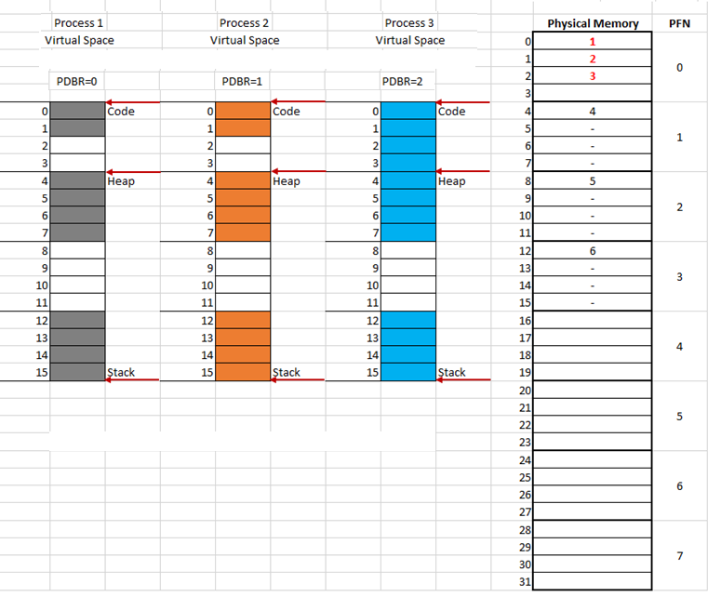
Example

Slide 39
Example

Slide 40
Summary
TLB (Translation Lookaside Buffer)
Part of the chip’s memory-management unit(MMU).
A hardware cache of popular virtual-to-physical address translation.
Advanced Paging
Big page size
Hybrid approach (paging + segmentation)
Multi-level page table
Next: Swapping (Chapters 21, 22)

